Slide 1
Floor Planning/Bin Packing

Slide 2

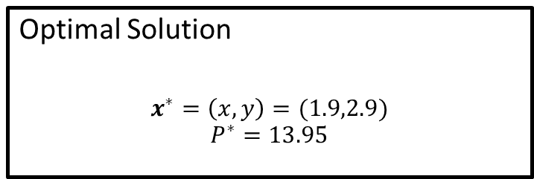


Linear Program
maximise $P=2x+3.5y$
subject to:
$$3x+2y≤14 \\ 2x+3y≤12.5 \\ −x+y≤1$$
and
$x,y≥0$
$$P=2x+3.5y$$
Optimal Solution
$$x^{∗}=\left(x,y\right)=(1.9,2.9)$$
$$P^{∗}=13.95$$

Slide 3
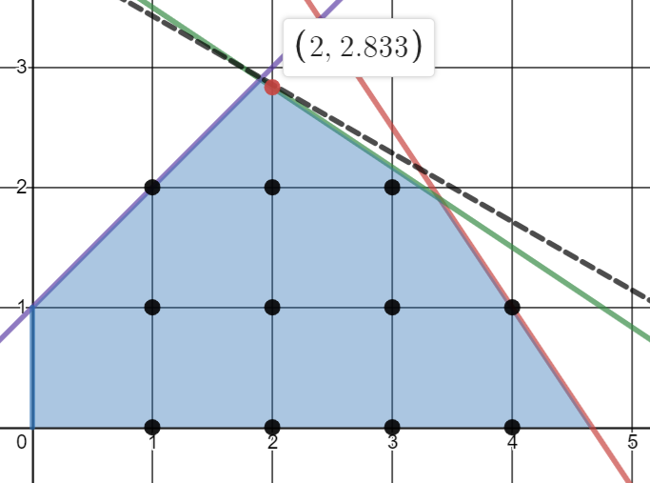
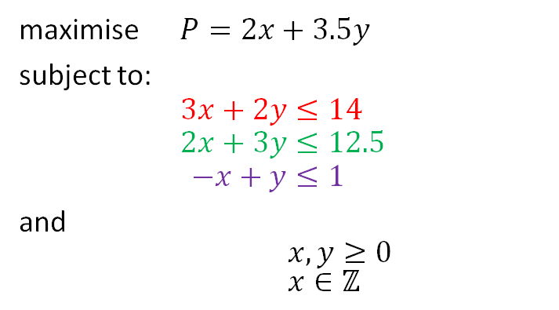

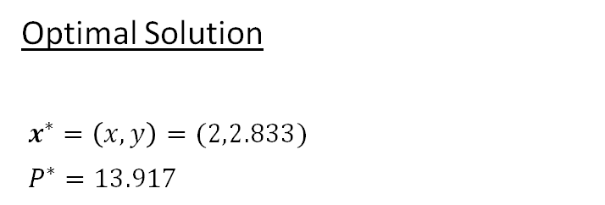
Mixed-Integer Program
maximise $P=2x+3.5y$
subject to:
$$3x+2y≤14 \\ 2x+3y≤12.5 \\ −x+y≤1$$
and
$x,y≥0$
$x∈ℤ$
$$P=2x+3.5y$$
Optimal Solution
$x^{∗}=\left(x,y\right)=(2,2.833)$
$P^{∗}=13.917$

Slide 4
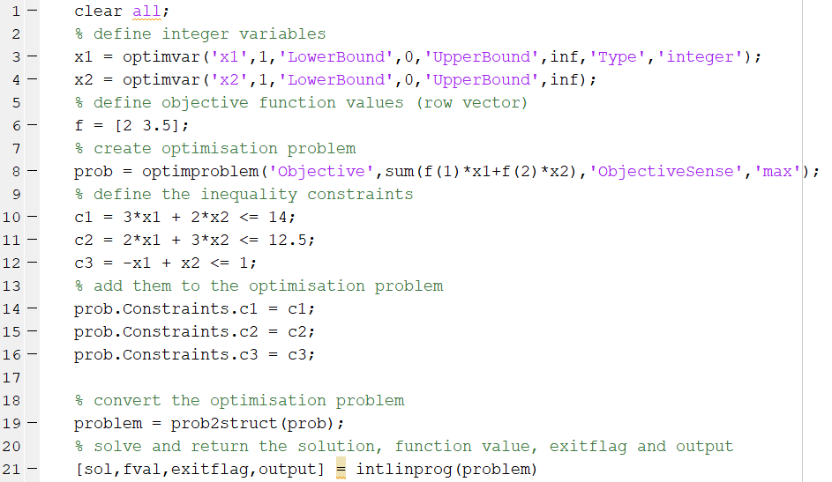
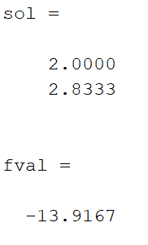
Mixed-Integer Solution (problem based)
maximise $P=2x+3.5y$
subject to:
$$3x+2y≤14 \\ 2x+3y≤12.5 \\ −x+y≤1$$
and
$x,y≥0$
$x∈ℤ$
Optimal Solution
$x^{∗}=\left(x,y\right)=(2,2.833)$
$P^{∗}=13.917$
MATLAB shows fval = −13.9167 because it solves the problem as “minimise −P”; so P* = 13.917.

Slide 5
2 Dimensional Floor Planning

Slide 6
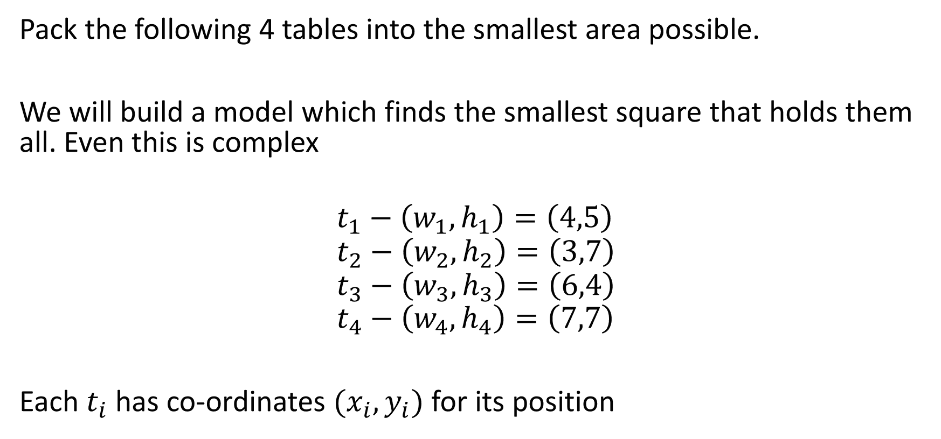
Floor Planning
Pack the following 4 tables into the smallest area possible.
We will build a model which finds the smallest square that holds them all. Even this is complex
$$t_{1}−\left(w_{1},h_{1}\right)=\left(4,5\right) \\ t_{2}−\left(w_{2},h_{2}\right)=\left(3,7\right) \\ t_{3}−\left(w_{3},h_{3}\right)=\left(6,4\right) \\ t_{4}−\left(w_{4},h_{4}\right)=\left(7,7\right)$$
Each $t_{i}$ has co-ordinates $(x_{i}, y_{i})$ for its position

Slide 7

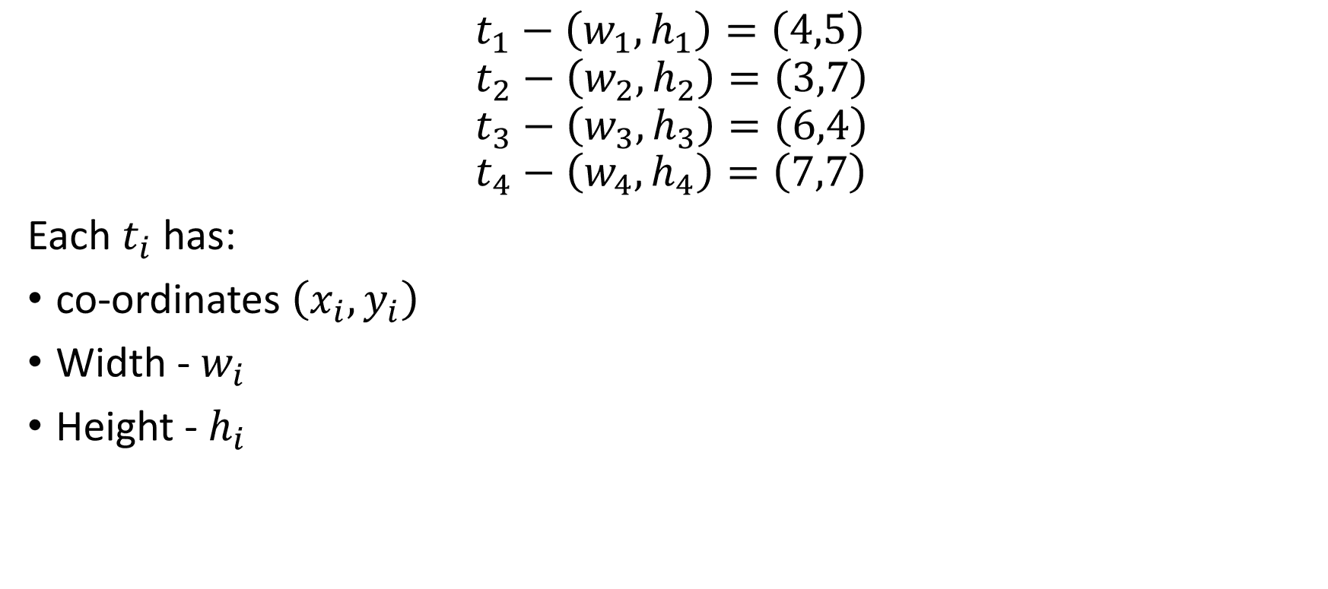



Floor Planning
$$t_{1}−\left(w_{1},h_{1}\right)=\left(4,5\right) \\ t_{2}−\left(w_{2},h_{2}\right)=\left(3,7\right) \\ t_{3}−\left(w_{3},h_{3}\right)=\left(6,4\right) \\ t_{4}−\left(w_{4},h_{4}\right)=\left(7,7\right)$$
Each $t_{i}$ has:
co-ordinates $\left(x_{i}, y_{i}\right)$
Width - $w_{i}$
Height - $h_{i}$
$$t_{i}$$
$$h_{i}$$
.
$$\left(x_{i}, y_{i}\right)$$
$$w_{i}$$

Slide 8
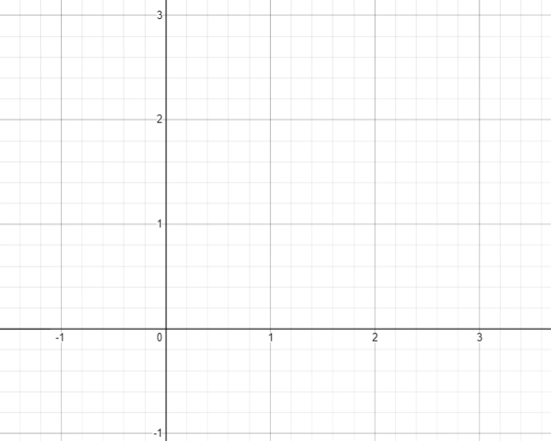

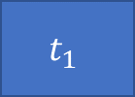
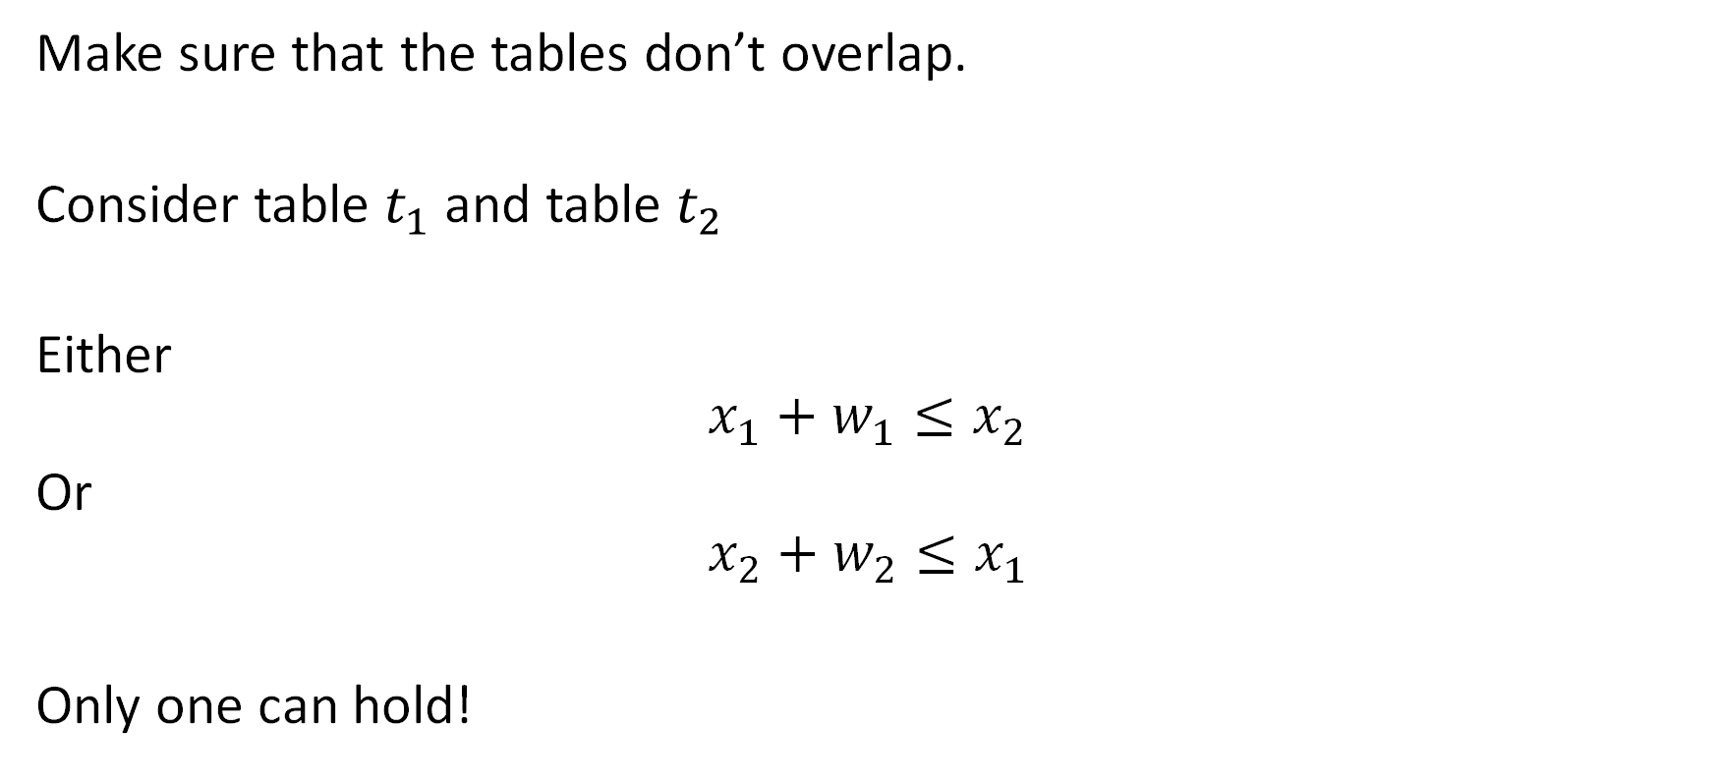
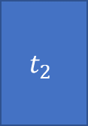


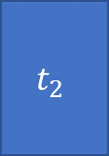

Non-overlapping constraints
$$t_{2}$$
Make sure that the tables don’t overlap.
Consider table $t_{1}$ and table $t_{2}$
Either
$$x_{1}+w_{1}≤x_{2}$$
Or
$$x_{2}+w_{2}≤x_{1}$$
Only one can hold!
$$t_{1}$$
$$t_{2}$$
$$t_{1}$$
$$t_{2}$$
$$t_{1}$$

Slide 9

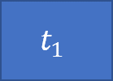
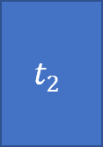
Intuition – 4 possible situations
$$x_{1}+w_{1}≤x_{2}$$
$$t_{2}$$
$$t_{1}$$

Slide 10

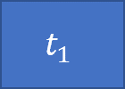
Intuition – 4 possible situations
$$x_{2}+w_{2}≤x_{1}$$
$$t_{2}$$
$$t_{1}$$

Slide 11

Intuition – 4 possible situations
$$y_{1}+h_{1}≤y_{2}$$
$$t_{2}$$
$$t_{1}$$

Slide 12


Intuition – 4 possible situations
$$y_{2}+h_{2}≤y_{1}$$
$$t_{1}$$
$$t_{2}$$

Slide 13
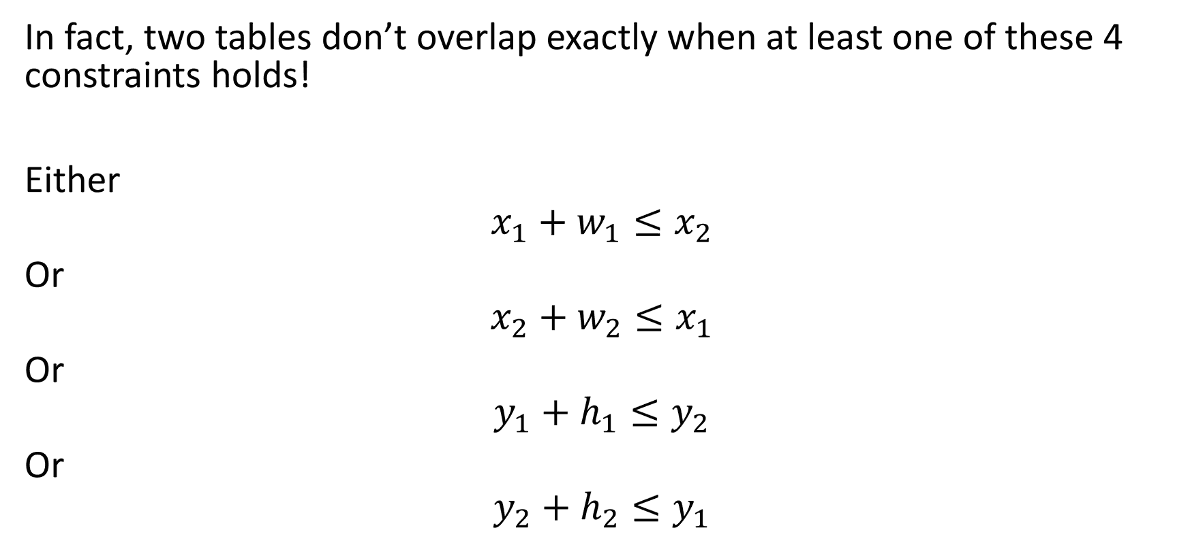
Non-overlapping constraints
In fact, two tables don’t overlap exactly when at least one of these 4 constraints holds!
Either
$$x_{1}+w_{1}≤x_{2}$$
Or
$$x_{2}+w_{2}≤x_{1}$$
Or
$$y_{1}+h_{1}≤y_{2}$$
Or
$$y_{2}+h_{2}≤y_{1}$$

Slide 14
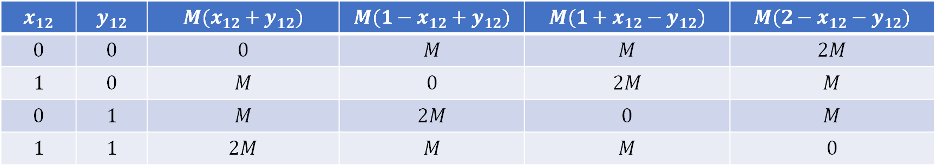
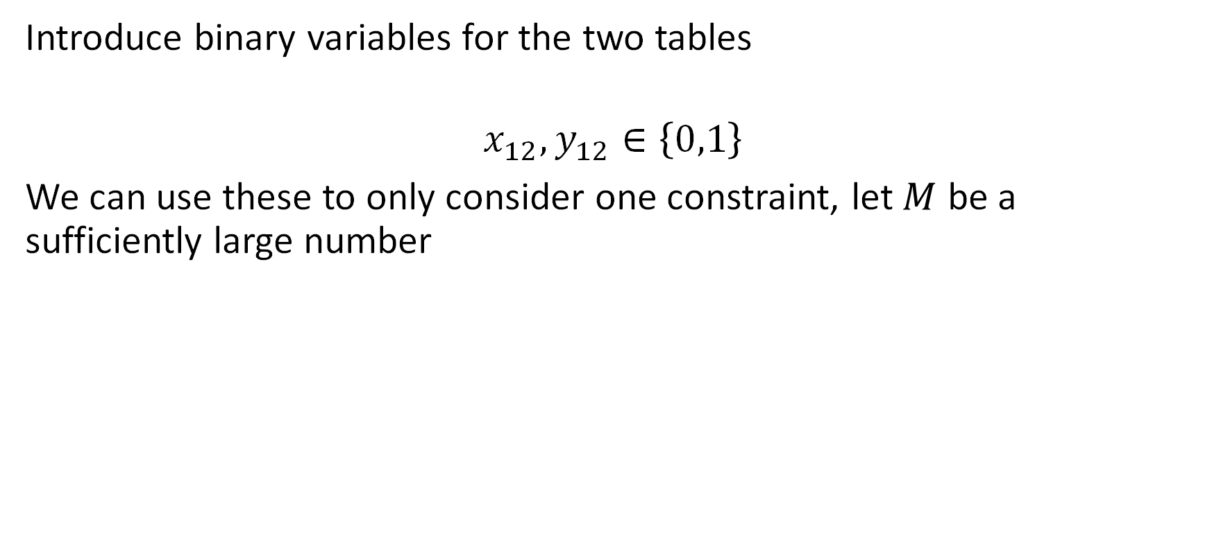
Binary Variables
Introduce binary variables for the two tables
$$x_{12},y_{12}∈\left\{0,1\right\}$$
We use them to choose which one of the four constraints must hold; let $M$ be a sufficiently large number
$$x_{12}$$ | $$y_{12}$$ | $$M(x_{12}+y_{12})$$ | $$M(1−x_{12}+y_{12})$$ | $$M(1+x_{12}−y_{12})$$ | $${M(2−x}_{12}−y_{12})$$
$$0$$ | $$0$$ | $$0$$ | $$M$$ | $$M$$ | $$2M$$
$$1$$ | $$0$$ | $$M$$ | $$0$$ | $$2M$$ | $$M$$
$$0$$ | $$1$$ | $$M$$ | $$2M$$ | $$0$$ | $$M$$
$$1$$ | $$1$$ | $$2M$$ | $$M$$ | $$M$$ | $$0$$

Slide 15
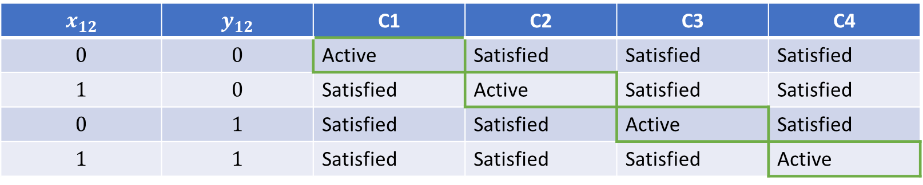
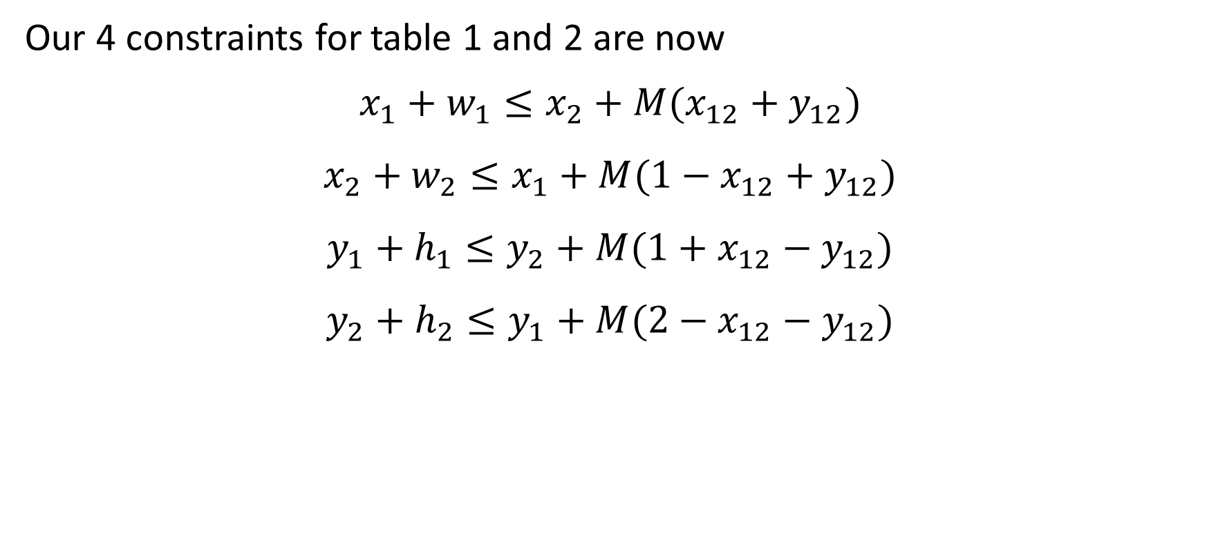
Non-overlapping constraints
Our 4 constraints for table 1 and 2 are now
$$x_{1}+w_{1}≤x_{2}+M(x_{12}+y_{12})$$
$$x_{2}+w_{2}≤x_{1}+M(1−x_{12}+y_{12})$$
$$y_{1}+h_{1}≤y_{2}+M(1+x_{12}−y_{12})$$
$$y_{2}+h_{2}≤y_{1}+M(2−x_{12}−y_{12})$$
$$x_{12}$$ | $$y_{12}$$ | C1 | C2 | C3 | C4
$$0$$ | $$0$$ | Active | Satisfied | Satisfied | Satisfied
$$1$$ | $$0$$ | Satisfied | Active | Satisfied | Satisfied
$$0$$ | $$1$$ | Satisfied | Satisfied | Active | Satisfied
$$1$$ | $$1$$ | Satisfied | Satisfied | Satisfied | Active

Slide 16
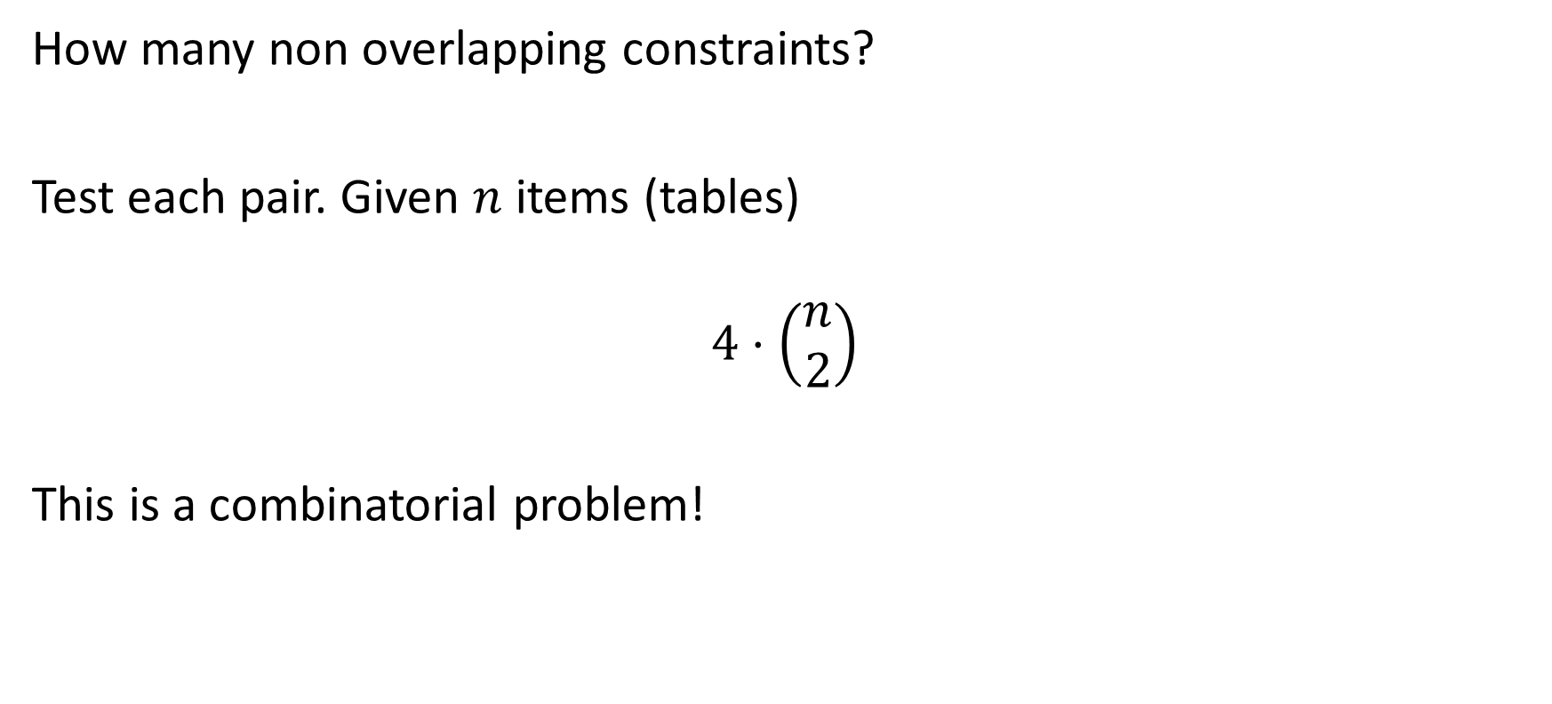
Non-overlapping constraints
How many non-overlapping constraints?
Test each pair. Given $n$ items (tables)
$$4⋅\left(\begin{matrix}n \\ 2\end{matrix}\right)$$
This is a combinatorial problem!

Slide 17
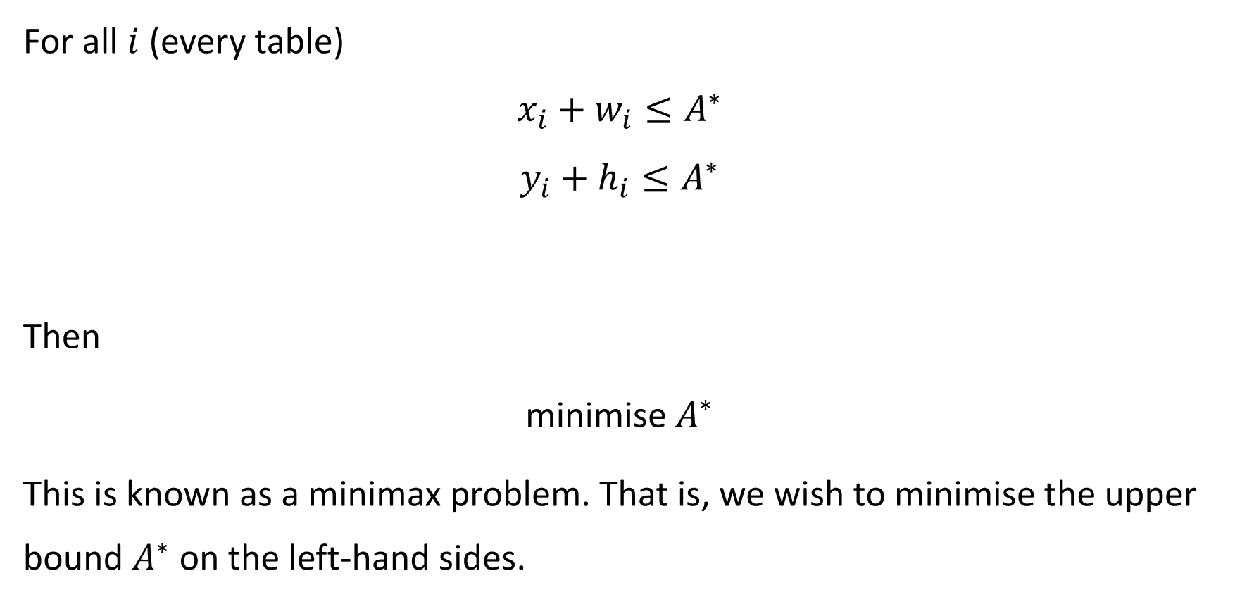
Objective
For all $i$ (every table)
$$x_{i}+w_{i}≤A^{∗}$$
$$y_{i}+h_{i}≤A^{∗}$$
Then
minimise $A^{∗}$
This is known as a minimax problem. That is, we wish to minimise the upper bound $A^{∗}$ on the left-hand sides.

Slide 18
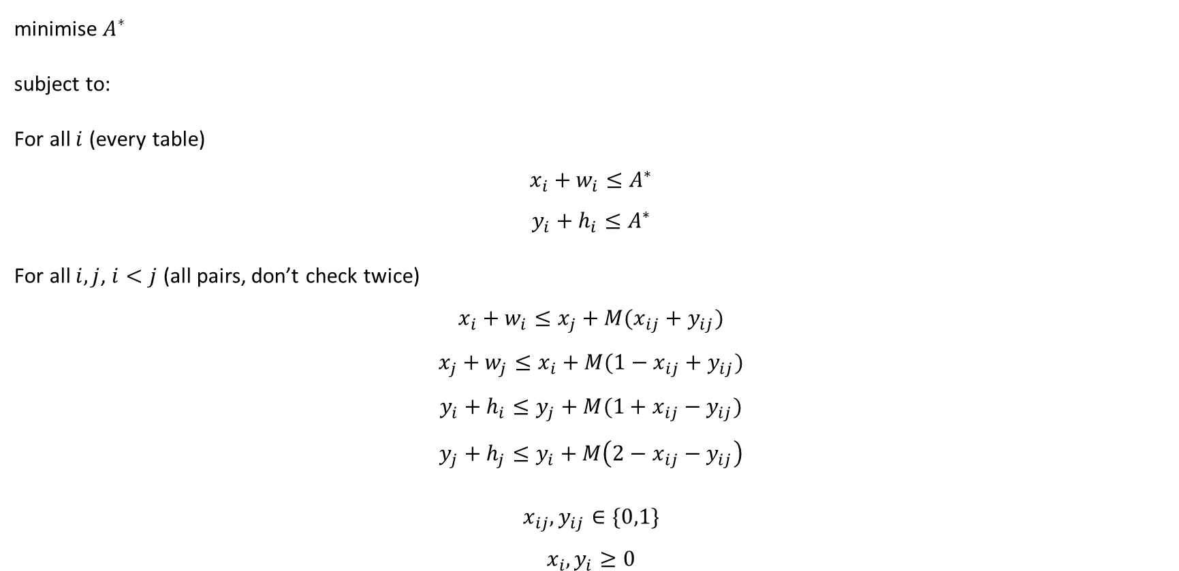
MILP Formulation
minimise $A^{∗}$
subject to:
For all $i$ (every table)
$$x_{i}+w_{i}≤A^{∗}$$
$$y_{i}+h_{i}≤A^{∗}$$
For all $i,j$, $i<j$ (all pairs, don’t check twice)
$$x_{i}+w_{i}≤x_{j}+M(x_{ij}+y_{ij})$$
$$x_{j}+w_{j}≤x_{i}+M(1−x_{ij}+y_{ij})$$
$$y_{i}+h_{i}≤y_{j}+M(1+x_{ij}−y_{ij})$$
$$y_{j}+h_{j}≤y_{i}+M\left(2−x_{ij}−y_{ij}\right)$$
$$x_{ij},y_{ij}∈\{0,1\}$$
$$x_{i},y_{i}≥0$$
Minimax constraints
Non-overlapping constraints
Variable constraints

Slide 19
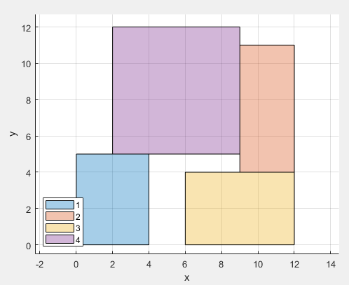
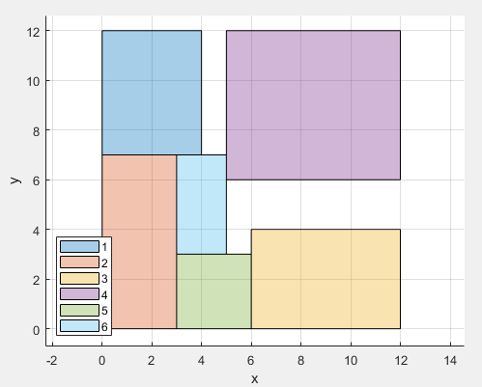
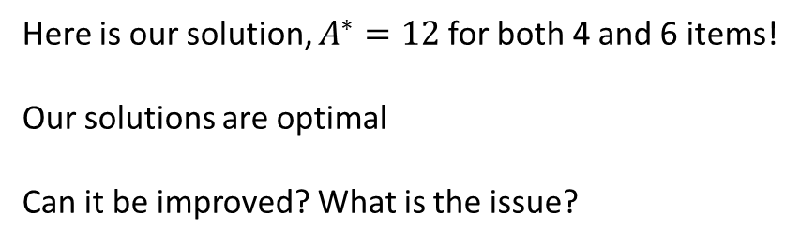
Solution
Right plot – items 1–6 (w, h): (4,5), (3,7), (6,4), (7,6), (3,3), (2,4); item 4 is 7×6 here.
Here is our solution, $A^{∗}=12$ for both 4 and 6 items!
Our solutions are optimal
Can it be improved? What is the issue?

Slide 20
Adding Rotation

Slide 21








Floor Planning
On rotation, width and height are swapped
$$t_{i}$$
$$t_{i}$$
$$w_{i}$$
$$h_{i}$$
.
.
$$\left(x_{i}, y_{i}\right)$$
$$\left(x_{i}, y_{i}\right)$$
$$w_{i}$$
$$h_{i}$$

Slide 22
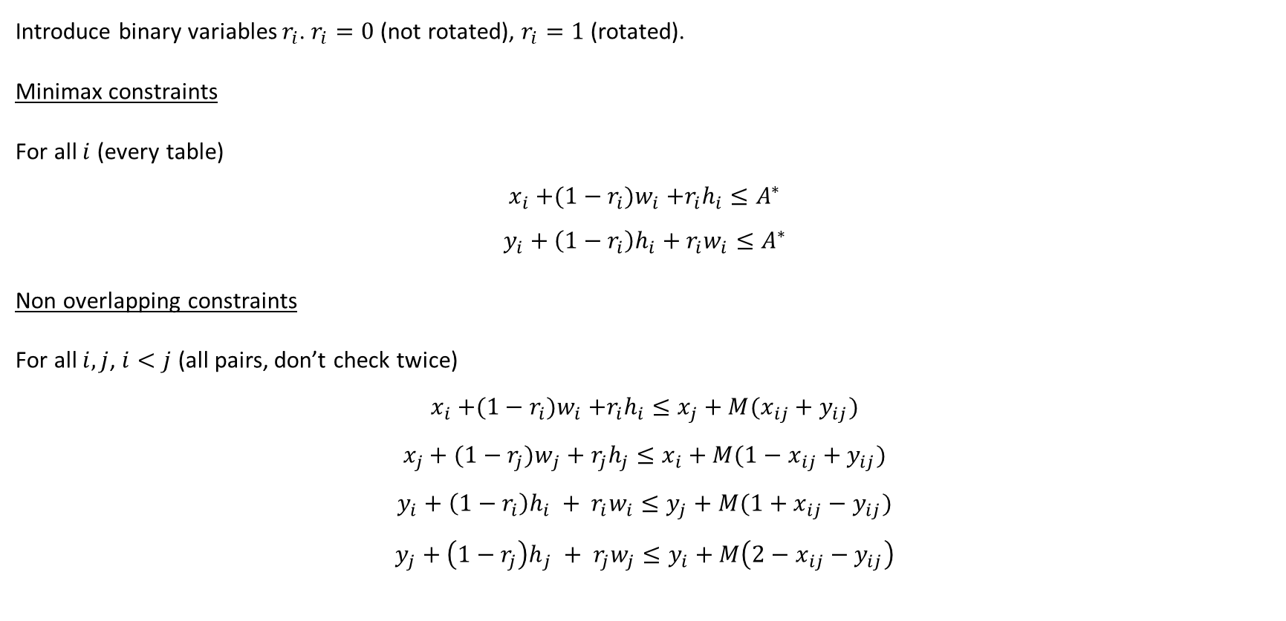
Amending the constraints
Introduce binary variables $r_{i}$. $r_{i}=0$ (not rotated), $r_{i}=1$ (rotated).
Minimax constraints
For all $i$ (every table)
$$x_{i}{+(1−r_{i})w}_{i}+r_{i}h_{i}≤A^{∗}$$
$$y_{i}+{\left(1−r_{i}\right)h}_{i}+r_{i}w_{i}≤A^{∗}$$
Non-overlapping constraints
For all $i,j$, $i<j$ (all pairs, don’t check twice)
$$x_{i}{+(1−r_{i})w}_{i}+r_{i}h_{i}≤x_{j}+M(x_{ij}+y_{ij})$$
$$x_{j}+{(1−r_{j})w}_{j} + r_{j}h_{j}≤x_{i}+M(1−x_{ij}+y_{ij})$$
$$y_{i}+{\left(1−r_{i}\right)h}_{i} + r_{i}w_{i}≤y_{j}+M(1+x_{ij}−y_{ij})$$
$$y_{j}+{\left(1−r_{j}\right)h}_{j} + r_{j}w_{j}≤y_{i}+M\left(2−x_{ij}−y_{ij}\right)$$

Slide 23
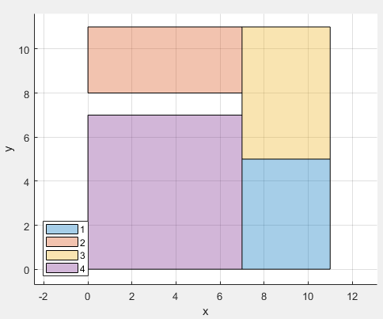

Solution
Here is our solution, $A^{∗}=11$. Improvement!
Can it be improved? This is dependent on your desired objective!

Slide 24
Connected 2 Dimensional Packing
Minimisation of the rectilinear distance between connected items

Slide 25
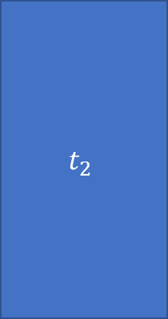

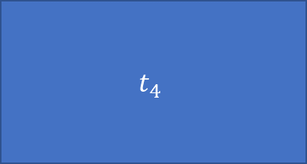
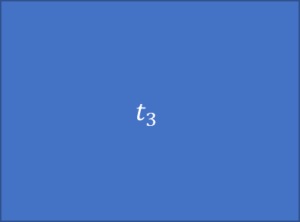
Clustering of components
Perhaps you have connected components that need to be close to each other and you have a fixed width/height for your floor space.
$$t_{2}$$
$$t_{3}$$
$$t_{1}$$
$$t_{4}$$

Slide 26
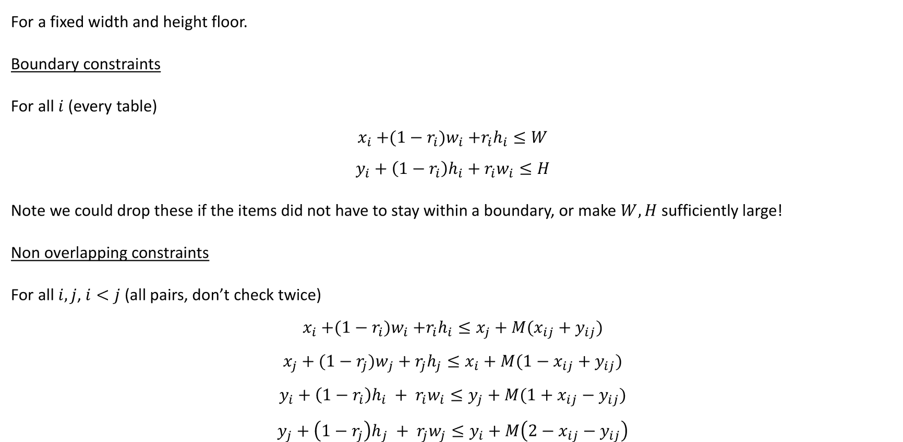
Amending the constraints
For a fixed width and height floor.
Boundary constraints
For all $i$ (every table)
$$x_{i}{+(1−r_{i})w}_{i}+r_{i}h_{i}≤W$$
$$y_{i}+{\left(1−r_{i}\right)h}_{i}+r_{i}w_{i}≤H$$
Note we could drop these if the items did not have to stay within a boundary, or make $W,H$ sufficiently large!
Non-overlapping constraints
For all $i,j$, $i<j$ (all pairs, don’t check twice)
$$x_{i}{+(1−r_{i})w}_{i}+r_{i}h_{i}≤x_{j}+M(x_{ij}+y_{ij})$$
$$x_{j}+{(1−r_{j})w}_{j} + r_{j}h_{j}≤x_{i}+M(1−x_{ij}+y_{ij})$$
$$y_{i}+{\left(1−r_{i}\right)h}_{i} + r_{i}w_{i}≤y_{j}+M(1+x_{ij}−y_{ij})$$
$$y_{j}+{\left(1−r_{j}\right)h}_{j} + r_{j}w_{j}≤y_{i}+M\left(2−x_{ij}−y_{ij}\right)$$

Slide 27
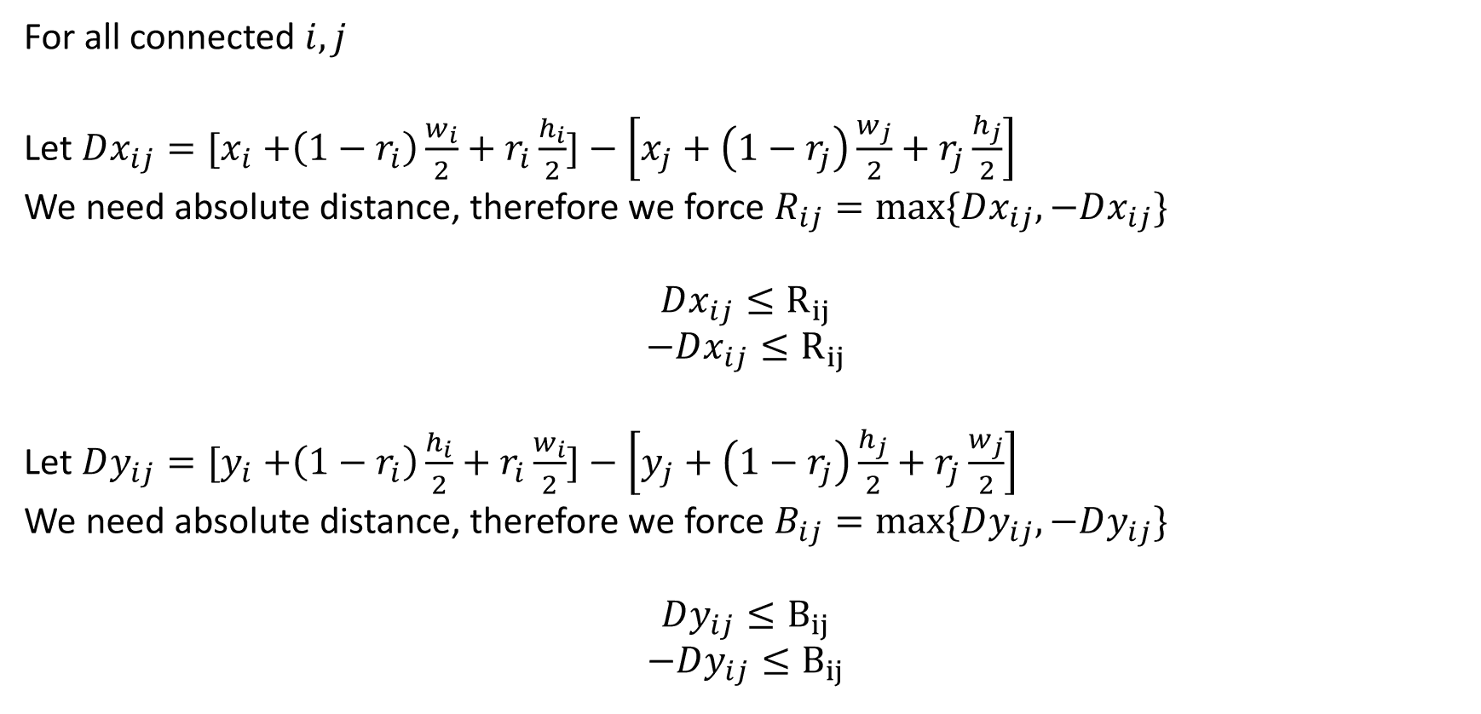
Distance between items (from centre points)
For all connected $i,j$
Let $Dx_{ij}={[x}_{i} +\left(1−r_{i}\right)\frac{w_{i}}{2}+r_{i}\frac{h_{i}}{2}]−\left[x_{j}+\left(1−r_{j}\right)\frac{w_{j}}{2}+r_{j}\frac{h_{j}}{2}\right]$
For the absolute distance we need $R_{ij}≥max⁡\{Dx_{ij},−Dx_{ij}\}$; minimising makes them equal.
$$Dx_{ij}≤R_{ij}$$
$$−Dx_{ij}≤R_{ij}$$
Let $Dy_{ij}={[y}_{i} +\left(1−r_{i}\right)\frac{h_{i}}{2}+r_{i}\frac{w_{i}}{2}]−\left[y_{j}+\left(1−r_{j}\right)\frac{h_{j}}{2}+r_{j}\frac{w_{j}}{2}\right]$
For the absolute distance we need $B_{ij}≥max⁡\{Dy_{ij},−Dy_{ij}\}$; minimising makes them equal.
$$Dy_{ij}≤B_{ij}$$
$$−Dy_{ij}≤B_{ij}$$

Slide 28
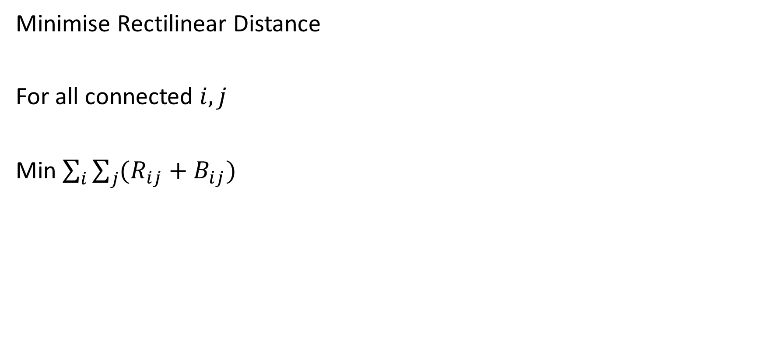
Objective Function
Minimise Rectilinear Distance
For all connected $i,j$
Min $\sum_{i}{\sum_{j}{(R_{ij}+B_{ij})}}$

Slide 29
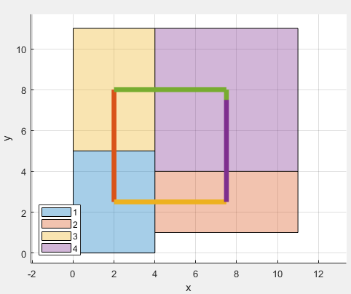
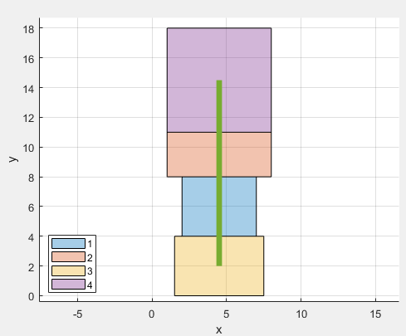
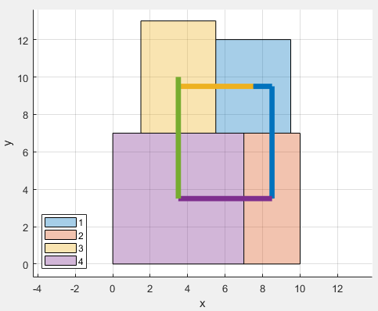



Results for different floor spaces
$$W=20, H=20$$
$$W=8, H=20$$
$$W=10, H=15$$

Slide 30
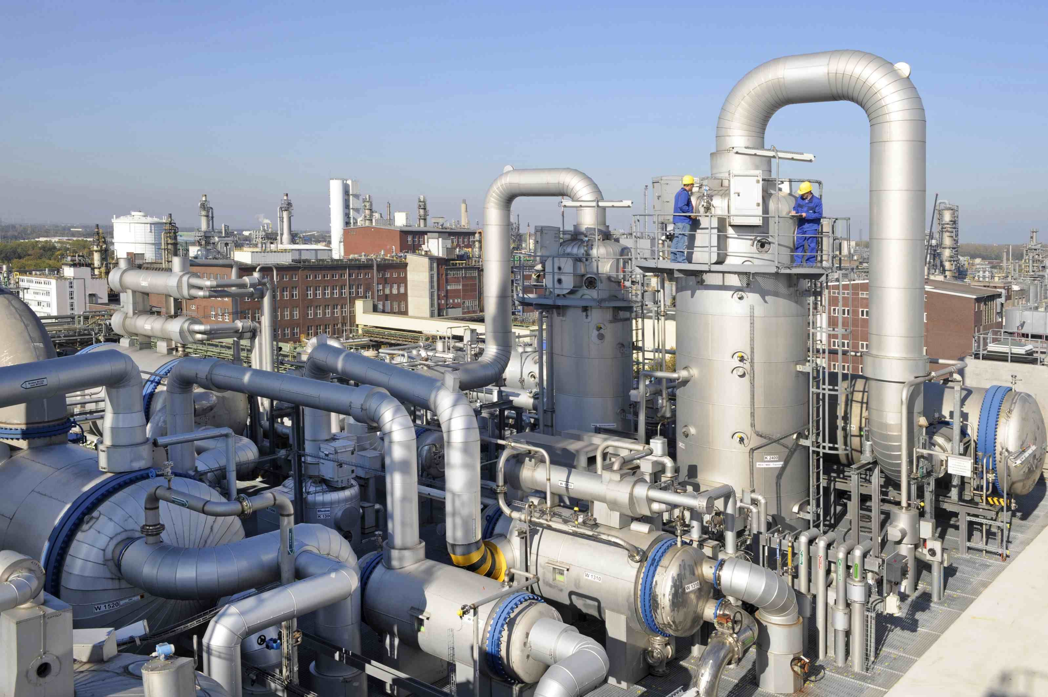
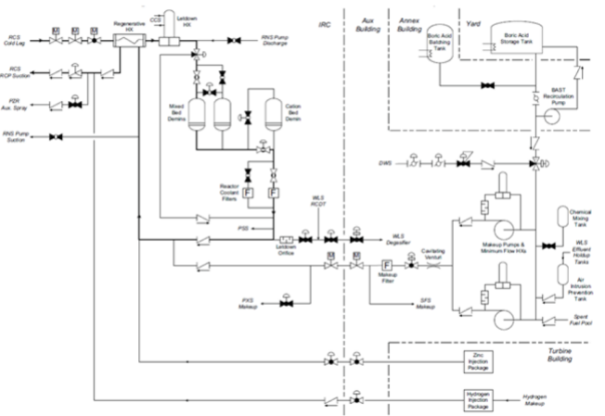
Problem

Slide 31
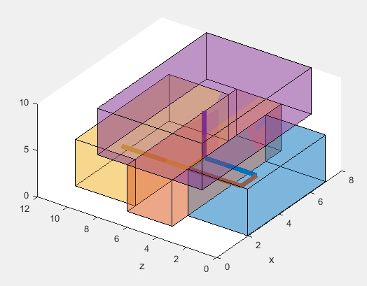
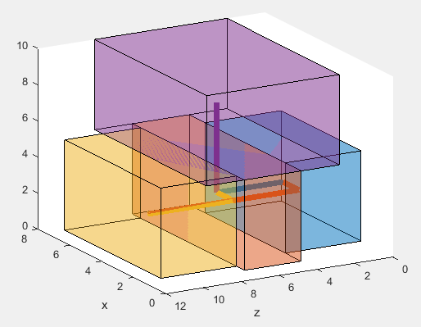
Example Solution
This is a simplified plot, the boxes contain enough space to include the piping.
It also requires structures to support items off the floor!

Slide 32
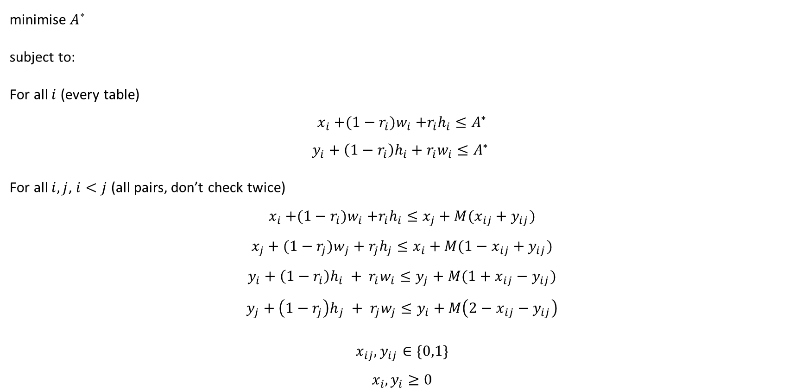
Returning to our simple packing problem
minimise $A^{∗}$
subject to:
For all $i$ (every table)
$$x_{i}{+(1−r_{i})w}_{i}+r_{i}h_{i}≤A^{∗}$$
$$y_{i}+{\left(1−r_{i}\right)h}_{i}+r_{i}w_{i}≤A^{∗}$$
For all $i,j$, $i<j$ (all pairs, don’t check twice)
$$x_{i}{+(1−r_{i})w}_{i}+r_{i}h_{i}≤x_{j}+M(x_{ij}+y_{ij})$$
$$x_{j}+{(1−r_{j})w}_{j} + r_{j}h_{j}≤x_{i}+M(1−x_{ij}+y_{ij})$$
$$y_{i}+{\left(1−r_{i}\right)h}_{i} + r_{i}w_{i}≤y_{j}+M(1+x_{ij}−y_{ij})$$
$$y_{j}+{\left(1−r_{j}\right)h}_{j} + r_{j}w_{j}≤y_{i}+M\left(2−x_{ij}−y_{ij}\right)$$
$$x_{ij},y_{ij},r_{i}∈\{0,1\}$$
$$x_{i},y_{i}≥0$$
Minimax constraints
Non-overlapping constraints
Variable constraints

Slide 33
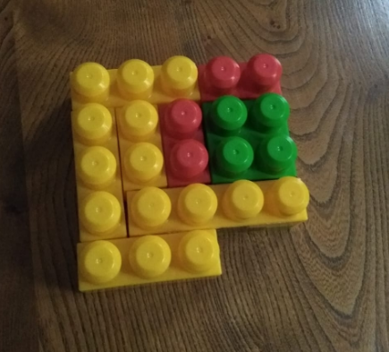
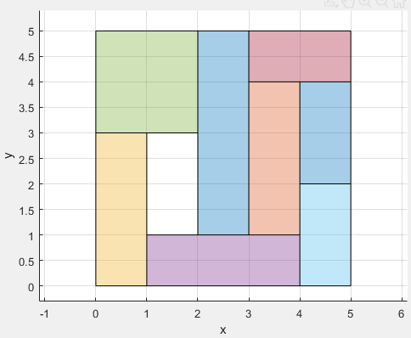
Mums Know Best!
Approximately 10 minutes!
4,936,427 solutions explored
Note that the optimal was actually found in 0.6 seconds, but the program doesn’t know it’s optimal
Approximately 20 seconds
Approximately 4 solutions explored

Slide 34
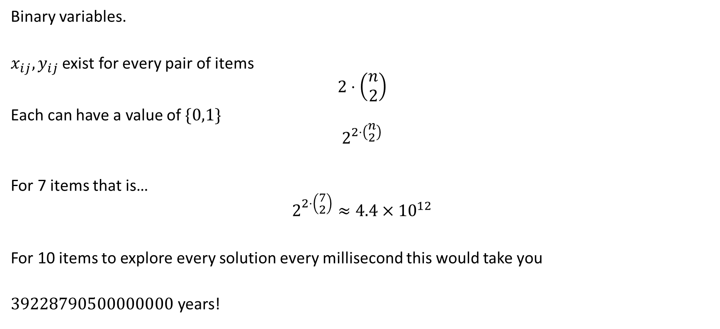
Why so inefficient?
Binary variables.
$x_{ij},y_{ij}$ exist for every pair of items
$$2⋅\left(\begin{aligned}n \\ 2\end{aligned}\right)$$
Each can have a value of $\{0,1\}$
$$2^{2⋅\left(\begin{aligned}n \\ 2\end{aligned}\right)}$$
For 7 items that is…
$$2^{2⋅\left(\begin{aligned}7 \\ 2\end{aligned}\right)}≈4.4×{10}^{12}$$
For 10 items to explore every solution every millisecond this would take you
about $3.9×{10}^{16}$ years!
With rotation the n variables r_{i} are binary too, which multiplies this by a further 2^{n}.

Slide 35


Conclusion
How does Santa pack his sleigh?
NP-Hard Optimisation!
Or By Magic!

